Slide 1

Black-Belt Developer Techniques
Part 1
Gabriel Michaud
Owner and Independent ERP Consultant
Velixo
gabriel@Velixo.com | @gabrielmichaud | blog.Velixo.com
Notes:
Prep Notes

Slide 2
Welcome!
Part 1: Everyday tips and tricks
Part 2: Pushing the limits of Acumatica extensibility
Part 3: Showcase and dev community call to action
Notes:
Quick intro on the presentation

Slide 3
Part 1 – Everyday tips and tricks
What they don’t teach you at the (Acumatica) university

Slide 4

“Magic” Attributes and BQL Operands
”The best code is no code at all” – Jeff Atwood (StackOverflow, Discourse)
Notes:
BQL and attributes are deeply ingrained in the Acumatica. The power of these platform tool lies in their ability to do a lot of stuff declaratively, without having to write actual code. For example, you can make a field required or have a default value by using the PXDefault attribute. You could achieve the same results without the attribute, by using RowInserted and Persisting events, however that can quickly add up to a lot of code. Code that you need to test and maintain, and which can sometimes be tricky to write correctly. I’d like to show you some attributes which were added to Acumatica in the last few years, but which are not well know and that have very practical uses and which can help you streamline your graph code even further.

Slide 5

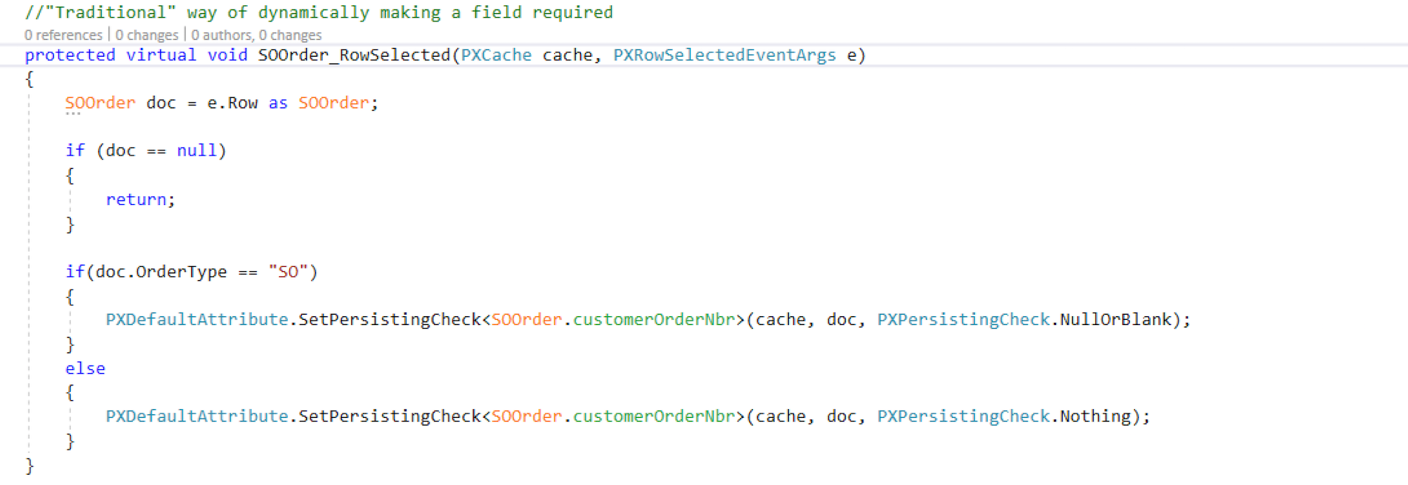
The ”traditional” way of making a field required (or visible, or enabled) dynamically

Slide 6
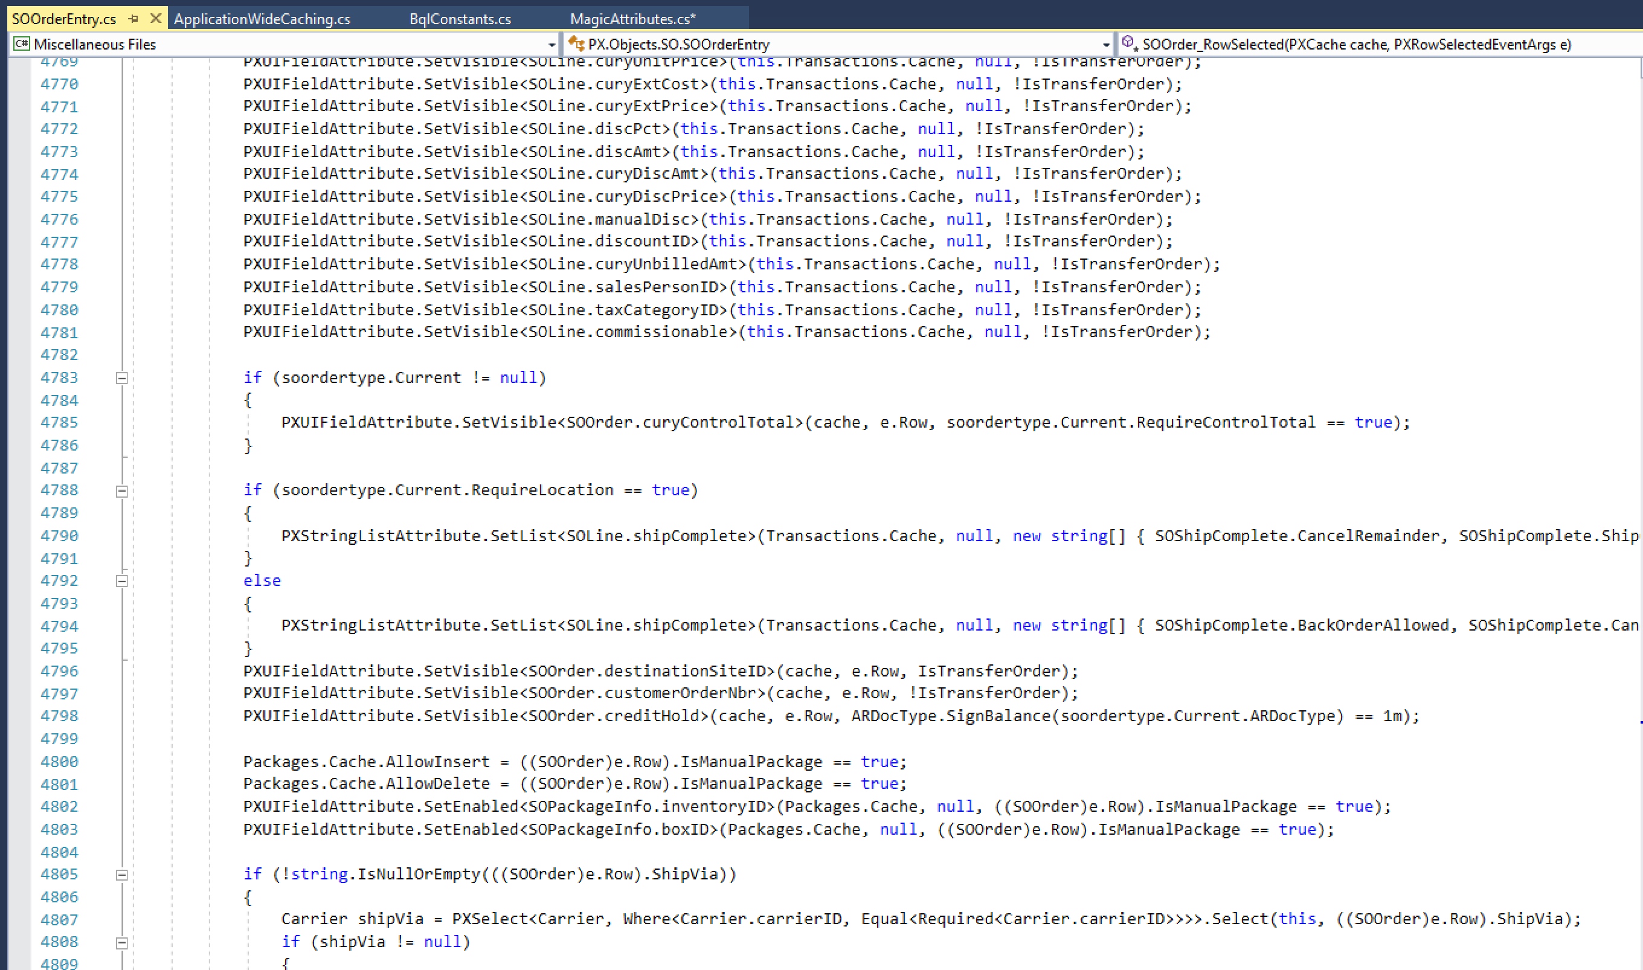
3 days (or hours) later…

Slide 7
“Magic” Attributes and BQL Operands
PXUIRequired(Type condition)
PXUIEnabled(Type condition)
PXUIVisible(Type condition) -> New in 2018 R1 Update 4
PXUIVerify(Type condition)
Related Operands
Selector<KeyField, Operand>
Default<Field, …>
Notes:
Example 1: PXUIRequired: Make CustomerOrderNbr required on SO Orders
Example 2: PXUIVisible: Project ID visible for Key Customers only (introduce Selector<>, alternative to doing DB query. Very fast.)
Example 3: PXUIVerify: Request date should be greater than order date
Example 4: PXUIEnabled+PXDefault+PXFormula trigger: Order description defaulted from Project and only editable for "X" (non-project code)
Example 5: PXFormula+Selector: Populate field on SOLine with MSRP value of currently selected item
General requirements
Most of the stuff that can be used in a PXFormula can be used in the PXUIAttributes; you could do a complex switch/case
Selector<>
Mention Performance benefits of Selector<> vs a Search<>
Can be used in PXFormula attribute as well, so you could use it to fill a field

Slide 8
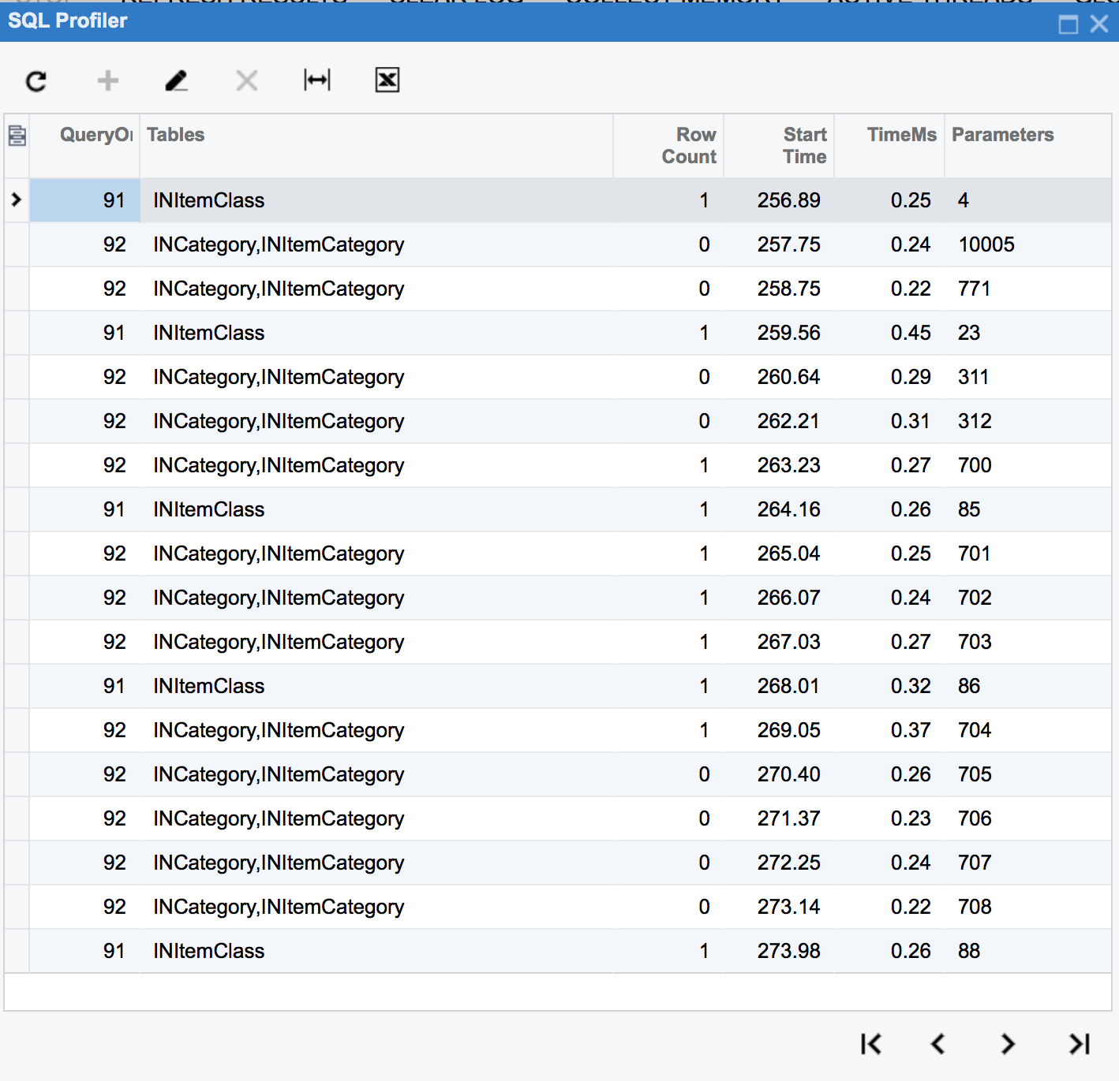
Application-wide data caching with slots and IPrefetchable
Use case: frequently accessed data that is expensive to load, reasonable in size and not updated frequently
Existing examples within Acumatica: user permissions, site map, segmented key configuration, discount rules
Acumatica takes care of initializing it on first access and invalidating the (whole) cache when a row changes
Notes:
Expensive to load - that can mean a web API call, something that requires evaluating or compiling an expression, like a regular expression, or simply a set of complex SQL queries

Slide 9
Optimizing your development environment – web.config tweaks
<appSettings>
CompilePages = FALSE
InstantiateAllCaches = FALSE
<compilation>
OptimizeCompilations = TRUE
Notes:
Also mention that it’s not just about initial load time – the application remains sluggish for a while after recompile because of CompilePages + InstantiateAllCaches!

Slide 10
Part 2 - Pushing the limits of Acumatica extensibility
Unsupported techniques that can save the day or land you in trouble

Slide 11

Notes:
In the next section I will be covering techniques that are at best, unsupported by Acumatica, and that may, at worst, stop working at any point in time. These techniques may however represent the only way to solve a particular challenge. I certainly don’t recommend that you start using these techniques tomorrow, but they are powerful and valuable enough that you should know about them!

Slide 12
Über-graph extensions
PXGraphExtension<Graph> where Graph : PXGraph
What would happen if we did PXGraphExtension<PXGraph> ?
Demos
Adding an action to every graph
Hooking into an event (Note field updated)
Notes:
http://10.211.55.13/AcumaticaDemo2018/Pages/GL/GL301000.aspx

Slide 13
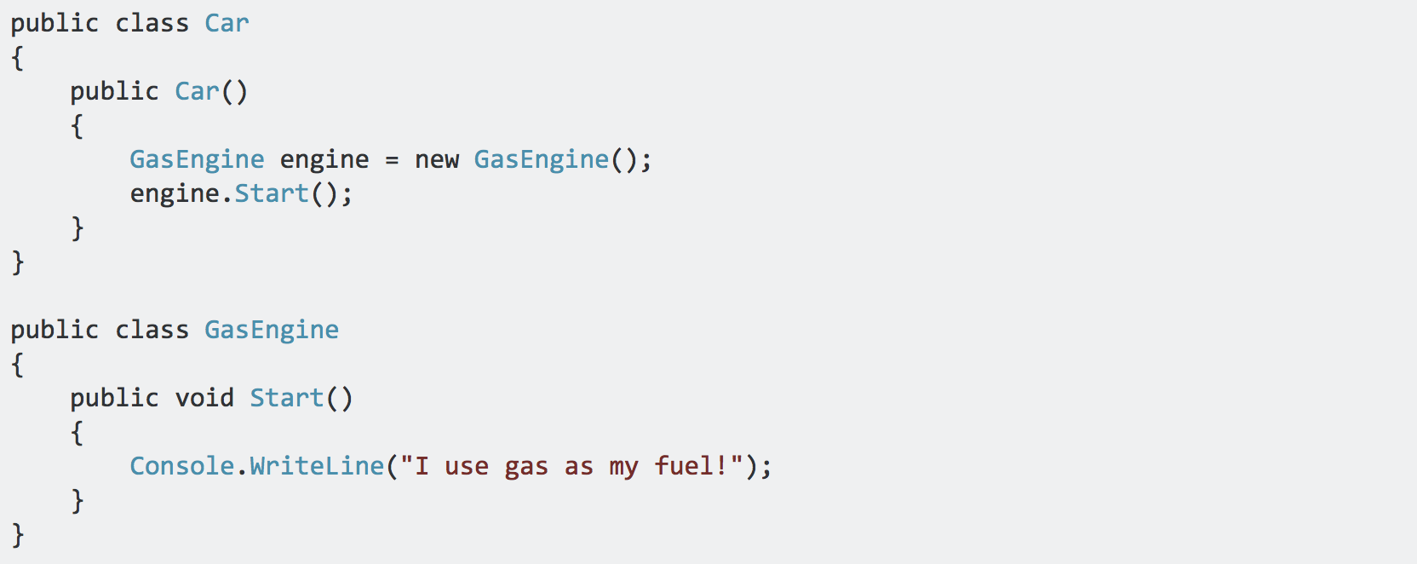
Dependency Injection with Acumatica
Traditionally, each object is responsible for obtaining its own references to the dependent objects it collaborates with:
Problems: Tightly coupled, hard to test
Source: https://stackoverflow.com/a/44945310/624448
Notes:
Let’s consider a simple example. A car. It requires an engine to run.
What if we want to change the gas engine used by the car for an electric engine? We need to rewrite the car class. Now imagine that you also have a Truck class and a Lawnmower that you also want to change to use an electric engine. They need to be rewritten too.
What about testing? How can we test the Car without having to test the engine at the same time?
These are all problems that dependency injection aims to solve

Slide 14
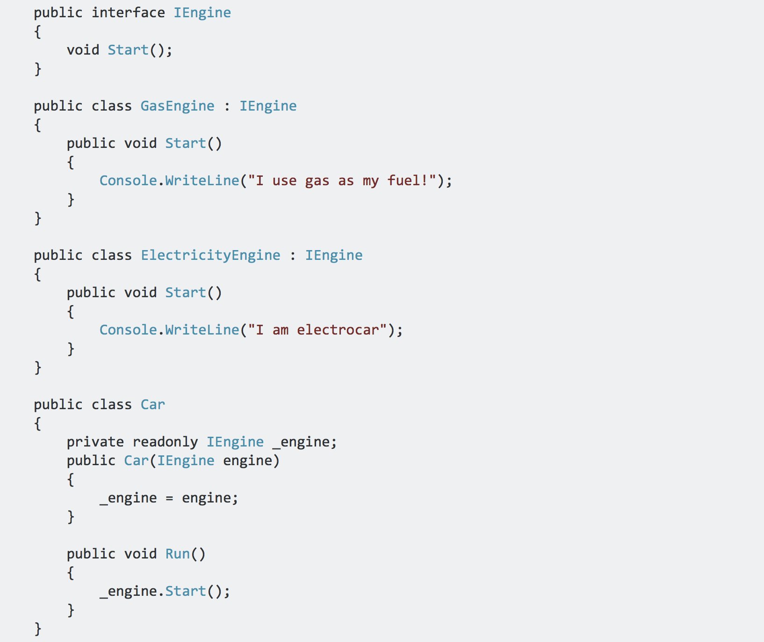
Dependency Injection with Acumatica
Source: https://stackoverflow.com/a/44945310/624448
Notes:
Now our Car class is dependent on only the IEngine interface, not a specific implementation of engine.
Now, the only trick is how do we create an instance of the Car and give it an actual concrete Engine class like GasEngine or ElectricityEngine.

Slide 15
Dependency Injection with Acumatica
Getting a new Car instance, the old fashioned way:
With the help of Dependency Injection:
Notes:
Here’s how we would get a new instance of the car. If we had other dependencies like that - a car has hundreds if not thousands of dependencies – the code would get really messy.
We also don’t want the caller to be responsible of knowing all the dependencies a car requires. That's where Dependency Injection comes in. The DI container takes care of getting us a new Car instance, and resolving all the dependencies.
We can change our engines to electric engines without having to modify the Car or classes that work with the car. And we can start consuming new services without having to modify the code that calls the Car.

Slide 16

Dependency Injection with Acumatica
Summary: DI is a technique for achieving loose coupling between objects and their dependencies. Rather than directly instantiating dependencies that class needs in order to perform its actions, dependencies are provided to the class by someone else
We typically delegate that responsibility to a framework:
Structure Map
Unity
Ninject
Castle Windsor
Autofac -> used by Acumatica
Current (public) uses inside Acumatica
Generic graph extensions (ref: 2018 R1 Framework Development Guide)
Demo
Notes:
DI is used in a few places inside Acumatica, mostly some of the newer components like OData, the Contract-Based API and Push Notifications. The only “visible” use is with generic graph extensions, a concept introduced in 2018 R1 to allow reusable business logic.
Demo:
Show where components are registered (”Module” class)
Show how dependencies are injected

Slide 17
Custom HTTP Handlers
Made possible by the Dependency Injection framework and ActivateOnApplicationStart
Demo

Slide 18

Notes:
And remember! With great power comes great responsibility!

Slide 19
Part 3 – Showcase and dev community call to action
Notes:
I’ve been programming for more than 20 years now, most of it doing ERP-related work, and the last 8 on the Acumatica Framework. There’s always something new to learn and I love to push things to their limit. Some of the techniques I have presented you today are things I learned while working on actual customer projects, but others are things I developed simply for the sake of learning, but also contributing to the community. I’d like to present you 3 projects that I’ve worked on in the last year and which are available on GitHub.

Slide 20
Velixo Mail Track: Acumatica/SendGrid Integration
Tracks delivery, open and click-through
Leverages Chrome push notifications to notify users instantly when an event occurs
Techniques: custom HTTP module, Chrome push notifications, source control automatic command-line build
Status: Production-ready
Link: github.com/gmichaud/Velixo-MailTrack

Slide 21
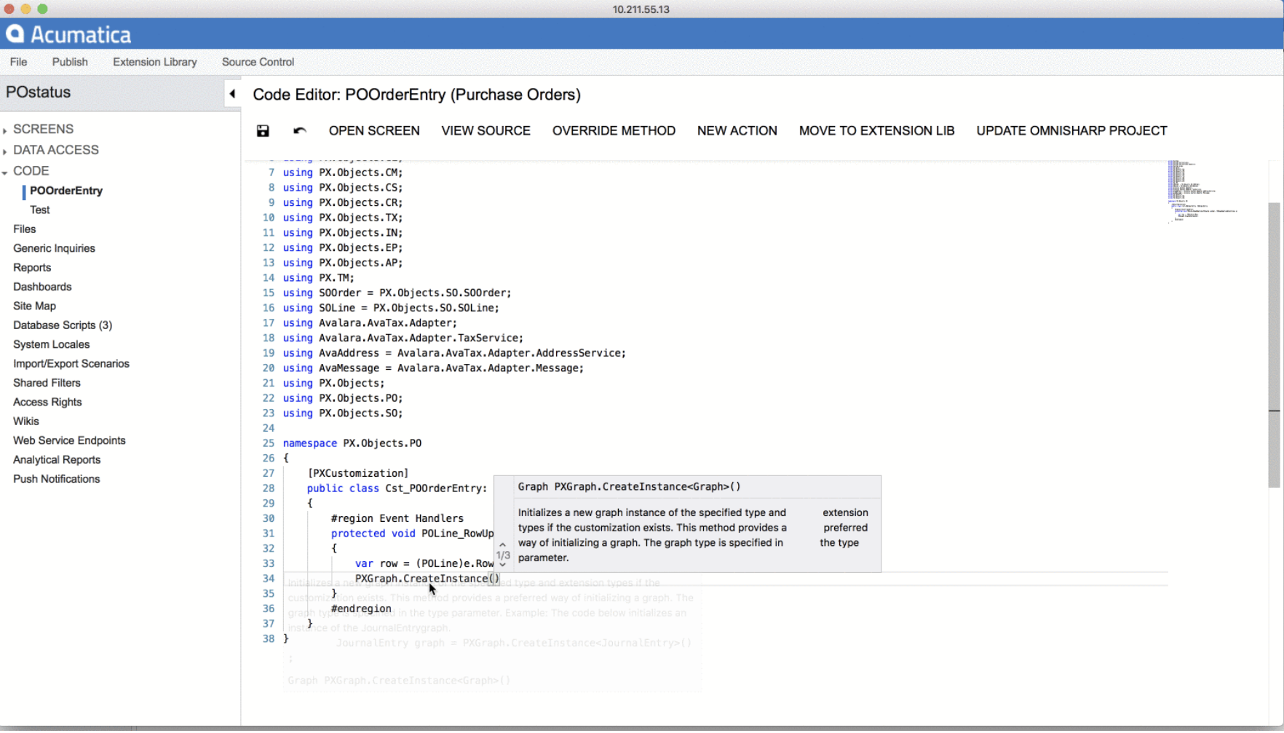
Velixo Code Editor for Acumatica
Techniques: custom HTTP module, custom title module, global graph extensions,PXDatabase.Subscribe<>, invoking private functions through reflection, embedding and loading external EXE file, replacing system pages
Status: Experimental
Link: github.com/gmichaud/Velixo-AcumaticaCodeEditor
Notes:
Initial idea I had was to create a scripting-like environment to allow adding actions dynamically to any screen as well as scheduled processing to generic inquiries. I had to build a code editor and I wanted to have modern capabilities like IntelliSense – I published the first phase of this project to GitHub. It uses the Monaco Editor built by Microsoft (same one in VS Code) as well as OmniSharp for the advanced editor services. I built the ”glue” between these components.
DEMO: Show new DAC fields appear in the intellisense after adding – without having to republish!
The project has been a learning exercise for me and I don't have much time to invest in it. If you want to contribute, here are some ideas of what could be improved:
Use websockets instead of HTTP POST calls to communicate with the /editor endpoint
Remove dependency on .NET Core SDK (or remove dependency on OmniSharp altogether and go straight to Roslyn, like try.dot.net)
Add support for more features supported by Monaco and OmniSharp like model markers (the red squiggly line that show up when you have an error in your code), editor commands, etc.
Build a REPL (read-evaluate-print-loop) that uses this editor and can be invoked from any screen in Acumatica

Slide 22
Velixo Reports: Analytical Reporting in Excel
The ease of use of Excel with the power of Acumatica Analytical Reports
Status: Production-ready (commercial version available)
Link: github.com/gmichaud/Velixo-Reports
More on my blog: blog.velixo.com

Slide 23

Thank You!
Code samples and presentation: https://github.com/gmichaud/BlackBeltTechniques
https://adn.Acumatica.com

